Slide 1


Supply Change and Business Data Analytics Competiton
Presented by – John Htun, Khaing Hlaing

Slide 2
What We Did
Summarize the data using excel charts
Use python to load and preprocess data
Prepare features and target variables
Split data into training and testing sets
Train Linear Regression models
Train Random Forest model
Extract feature importances from RFM(random forest models)
Created a predication model using RFM and evaluate performance
Process raw data into visual output
Notes:
Load and preprocess data:
Load the dataset and encode categorical variables using one-hot encoding.
Prepare features and target variables:
Define features (X) and target variables (y) for Math, Reading, and Writing scores.
Split data into training and testing sets:
Split the data into training and testing sets for each score type.
Train Linear Regression models:
Train separate Linear Regression models for Math, Reading, and Writing scores.
Evaluate Linear Regression models:
Predict scores using the trained models and calculate RMSE (Root Mean Squared Error) for each model.
Train Random Forest models:
Train separate Random Forest Regressor models for Math, Reading, and Writing scores.
Extract feature importances from Random Forest models:
Get and sort the feature importances for each score type using Random Forest models.
Visualize feature importances:
Plot bar charts to visualize the importance of each feature for each score type.
Prepare input data for prediction:
Create a function to prepare new input data for prediction, ensuring it matches the training dataset’s features.
Make predictions using Random Forest models:
Use the Random Forest model to predict test scores based on new input data.
Evaluate Random Forest model performance:
Calculate RMSE and R² score to assess the performance of the Random Forest models.
Visualization:
Display RMSE comparison and feature importance charts.

Slide 3
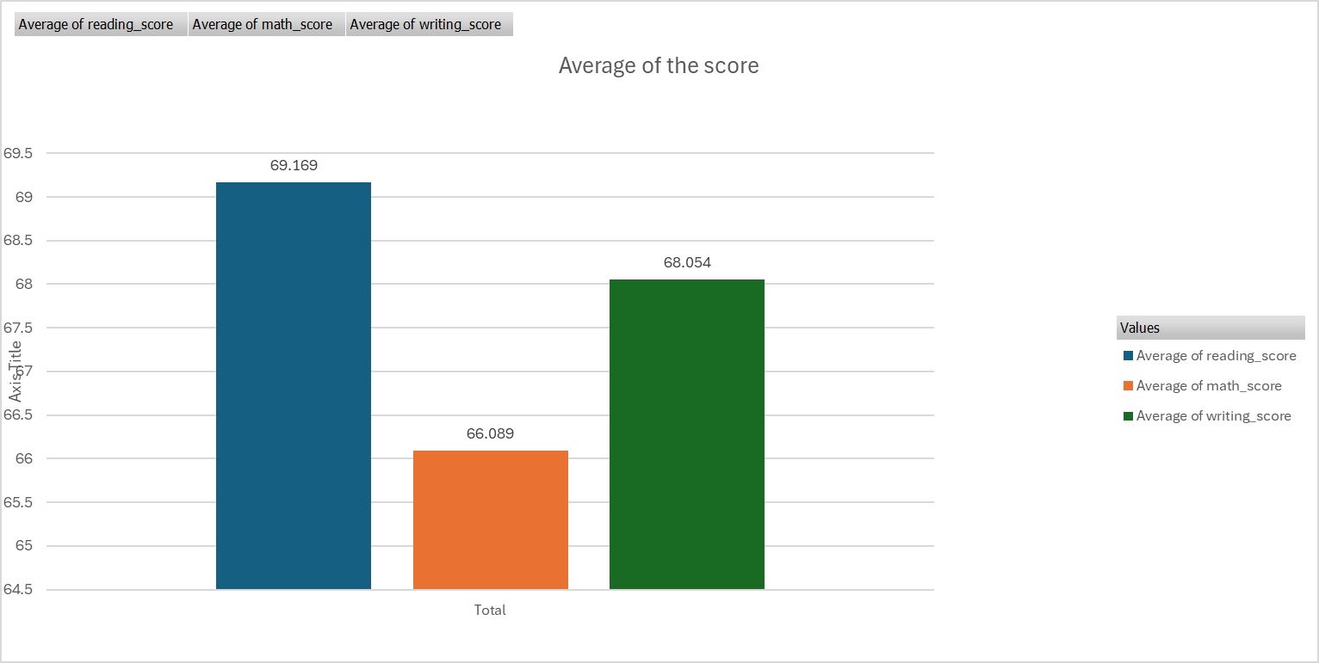
Notes:
In summary, Everyone tends to do better on maths test.

Slide 4
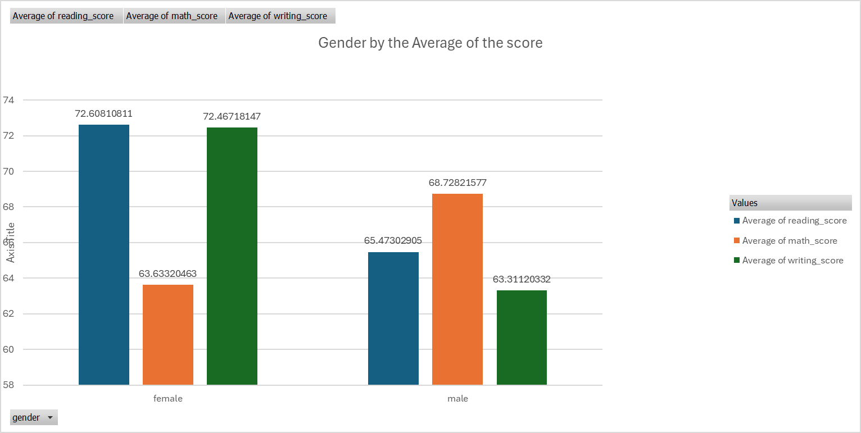
Notes:
Gender and the average score, see different a female tend to do better on reading and writing than maths.

Slide 5
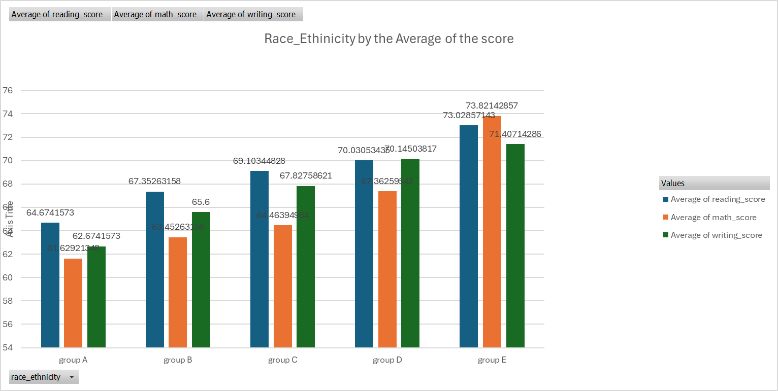
Notes:
In term of race, group E tend to do better than any of the group. Group A has the lowest performace. Steady increase can be noticed from group A,B,C,D to E

Slide 6
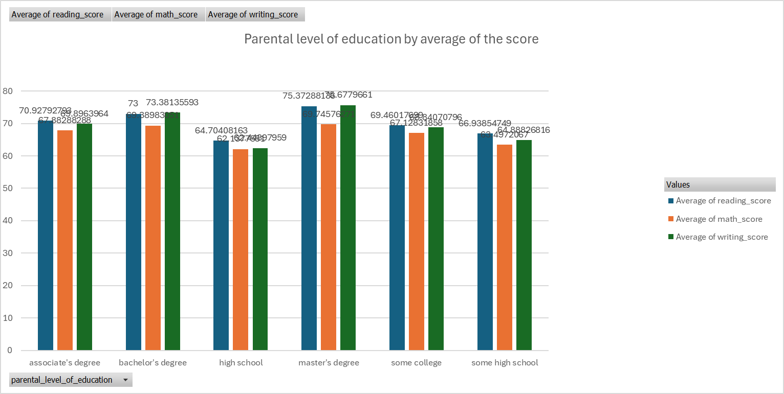
Notes:
Compare between parents education

Slide 7
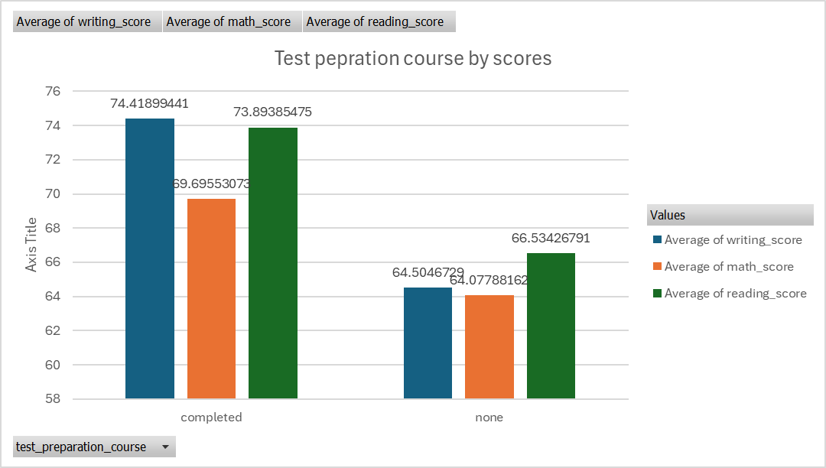

Slide 8
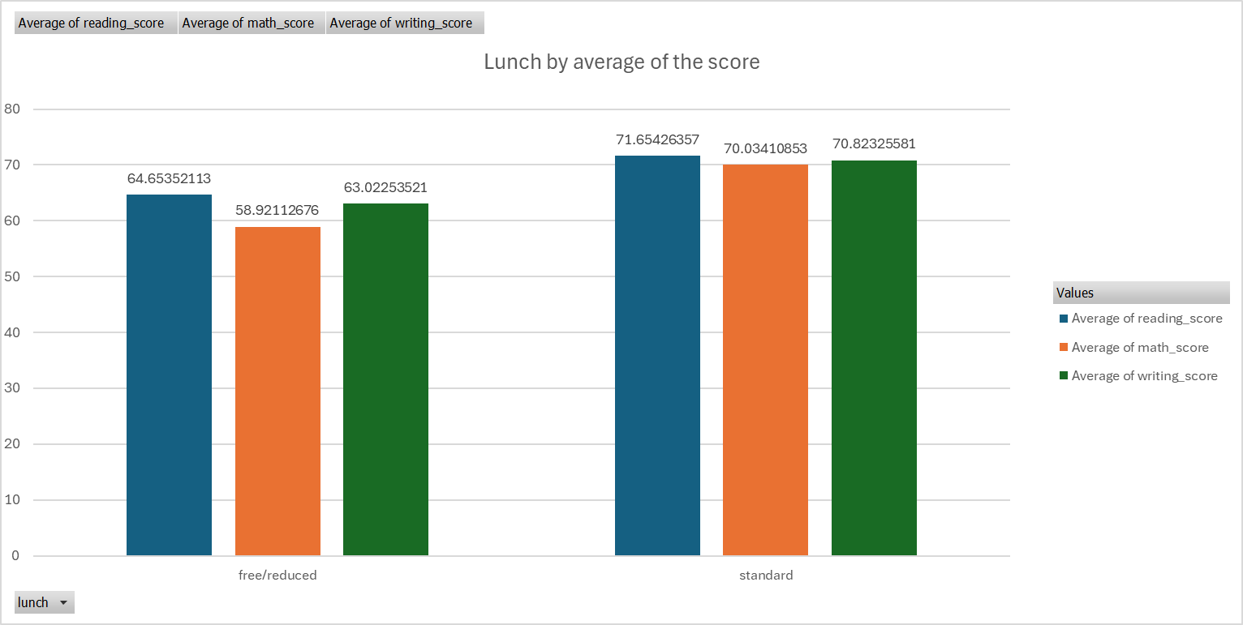

Slide 9
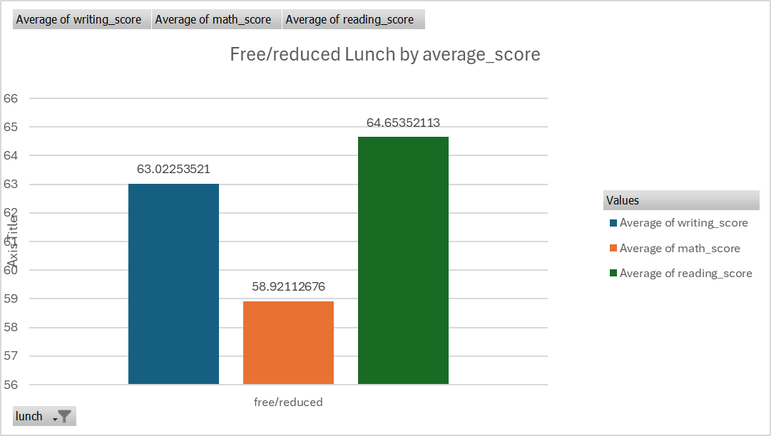

Slide 10
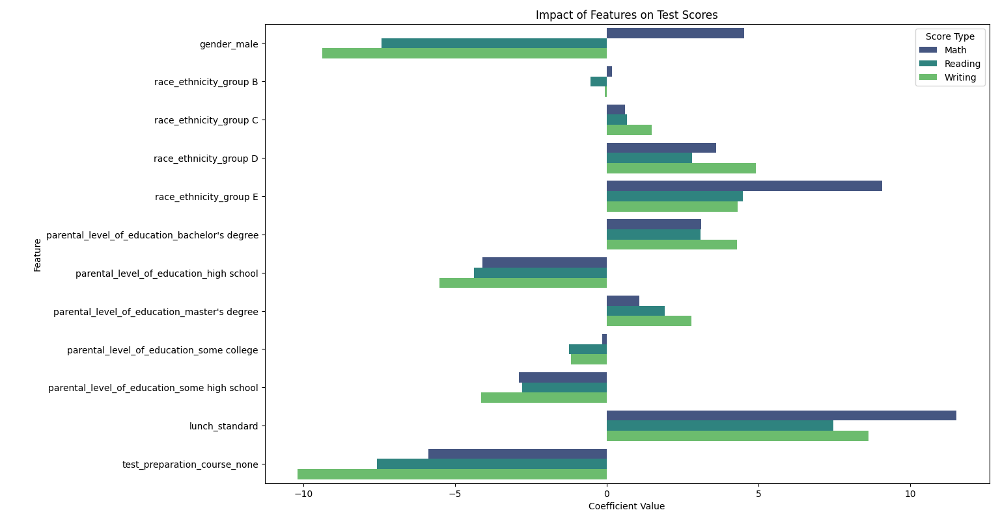
Coefficient Graph

Slide 11
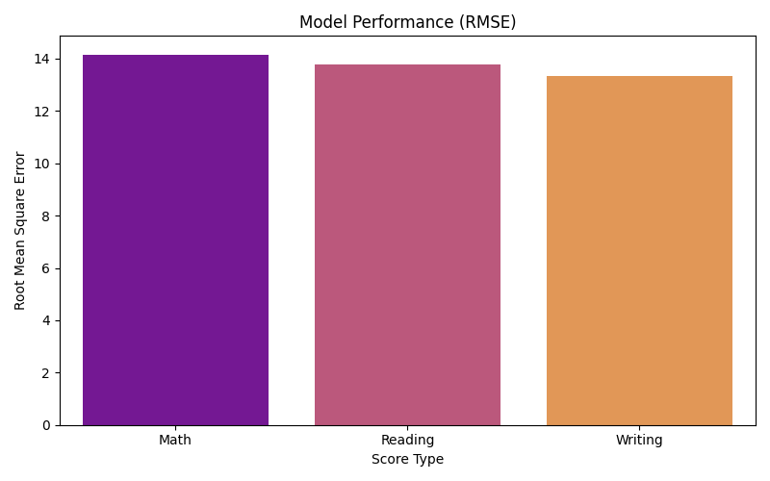

Slide 12
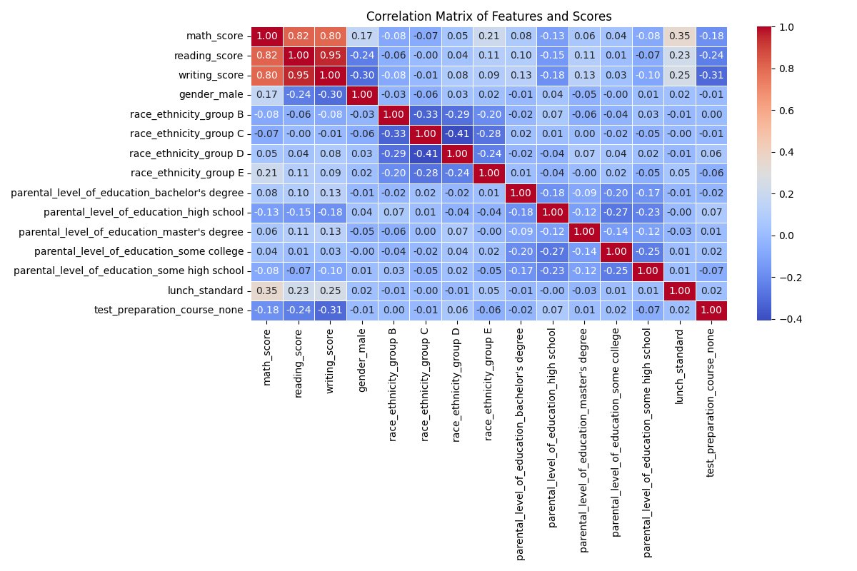

Slide 13
Coefficients in a Linear Regression Model
Math Coefficients:
gender_male: 4.520714
race_ethnicity_group B: 0.182362
race_ethnicity_group C: 0.602873
race_ethnicity_group D: 3.612132
race_ethnicity_group E: 9.077935
parental_level_of_education_bachelor's degree: 3.119051
parental_level_of_education_high school: -4.090503
parental_level_of_education_master's degree: 1.074605
parental_level_of_education_some college: -0.145008
parental_level_of_education_some high school: -2.896392
lunch_standard: 11.523997
test_preparation_course_none: -5.874513

Slide 14
Reading Coefficients:
gender_male: -7.413715
race_ethnicity_group B: -0.530336
race_ethnicity_group C: 0.674216
race_ethnicity_group D: 2.812013
race_ethnicity_group E: 4.484857
parental_level_of_education_bachelor's degree: 3.100665
parental_level_of_education_high school: -4.373968
parental_level_of_education_master's degree: 1.917664
parental_level_of_education_some college: -1.242754
parental_level_of_education_some high school: -2.786419
lunch_standard: 7.465526
test_preparation_course_none: -7.571180

Slide 15
Writing Coefficients:
Writing Coefficients:
gender_male: -9.382566
race_ethnicity_group B: -0.071518
race_ethnicity_group C: 1.476715
race_ethnicity_group D: 4.918428
race_ethnicity_group E: 4.317844
parental_level_of_education_bachelor's degree: 4.286589
parental_level_of_education_high school: -5.506417
parental_level_of_education_master's degree: 2.792913
parental_level_of_education_some college: -1.174547
parental_level_of_education_some high school: -4.136177
lunch_standard: 8.633442
test_preparation_course_none: -10.187402

Slide 16
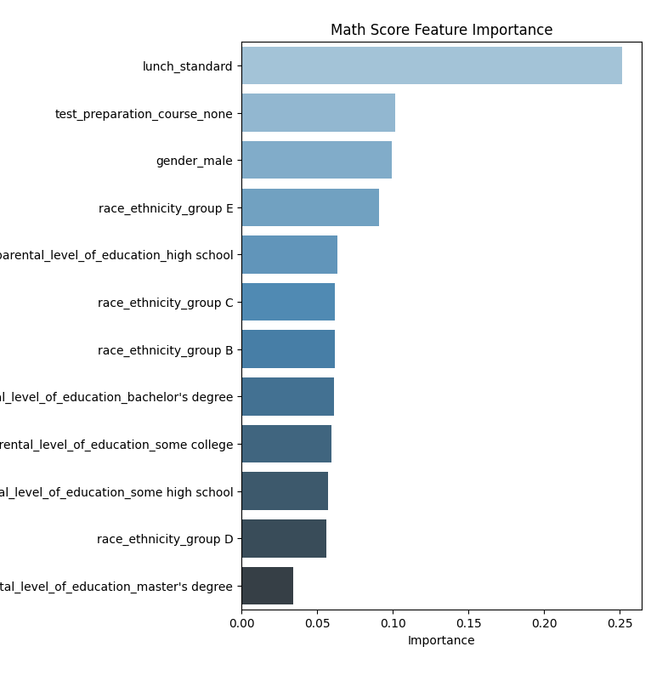
Random Forest Model

Slide 17
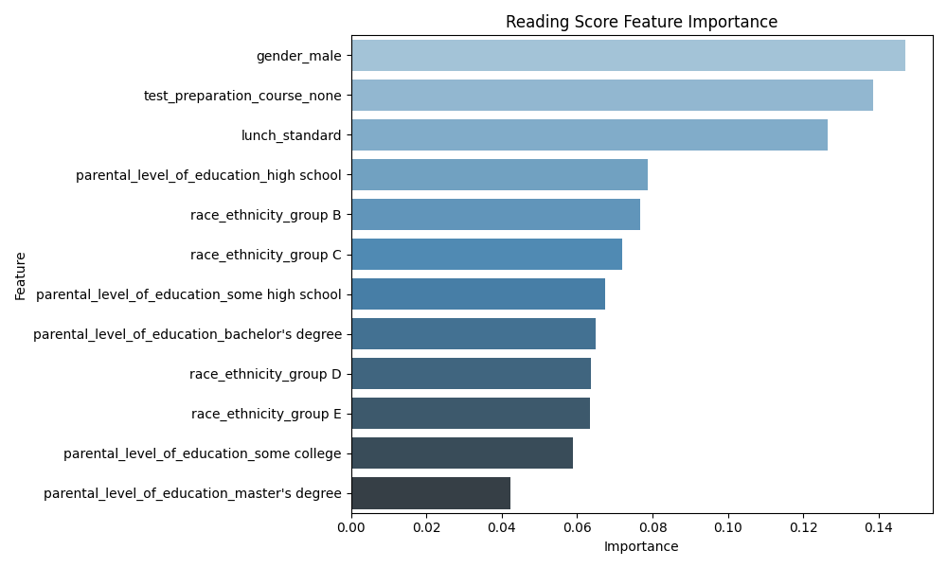

Slide 18
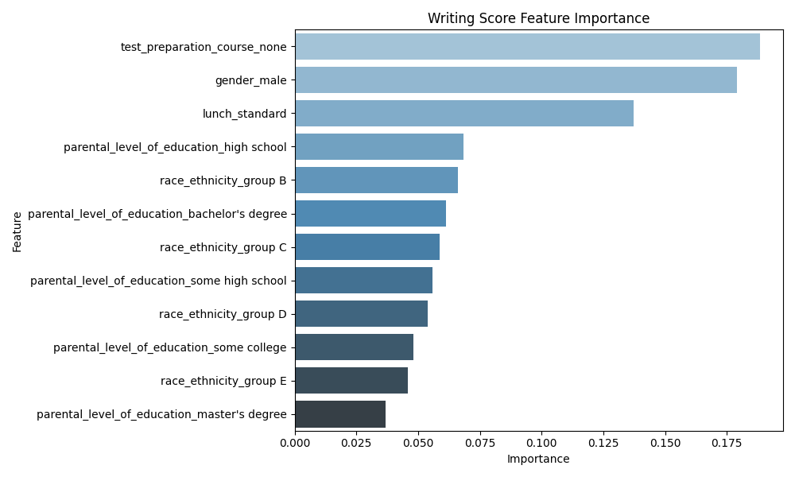

Slide 19
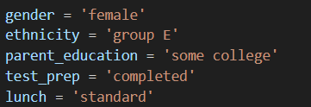
RFM Predication
Reading RMSE: 15.18
Reading R² Score: -0.02
Predicted Reading Score: 79.13

Slide 20
Conclusion

